Slide 1



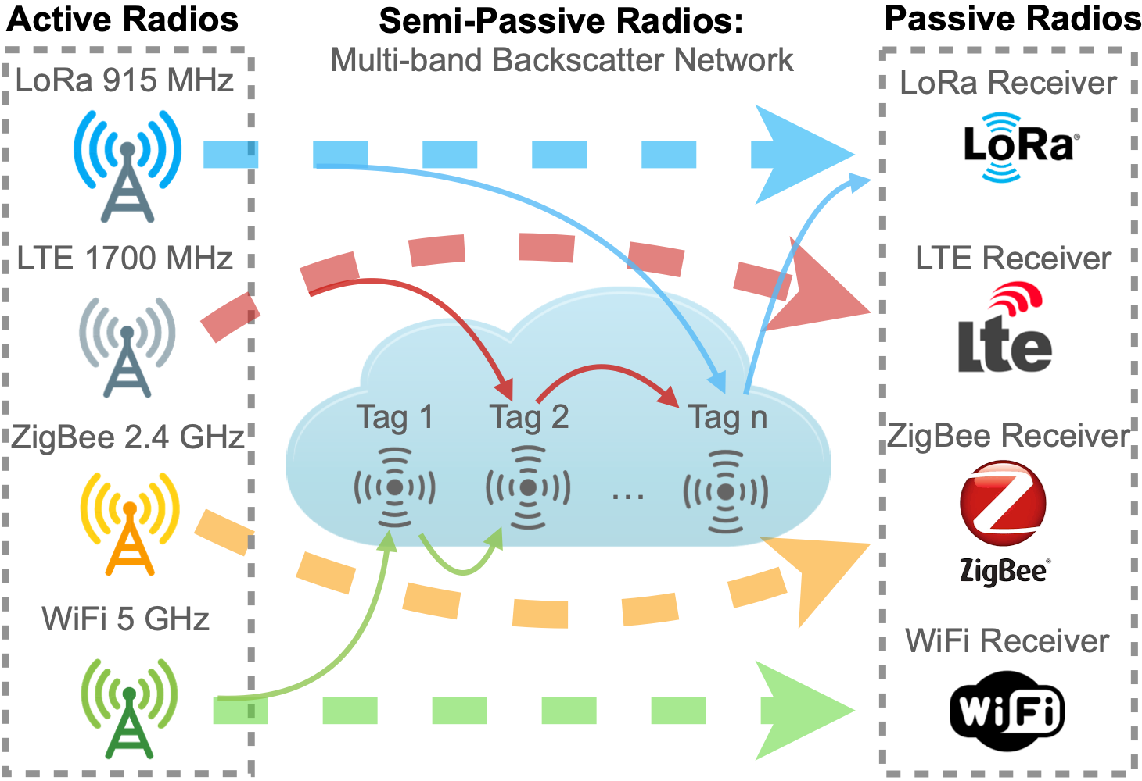
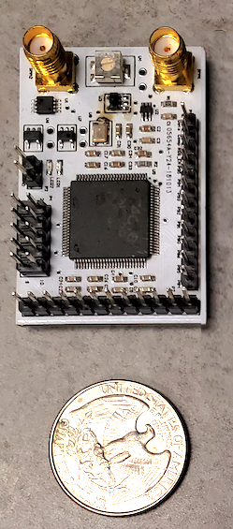
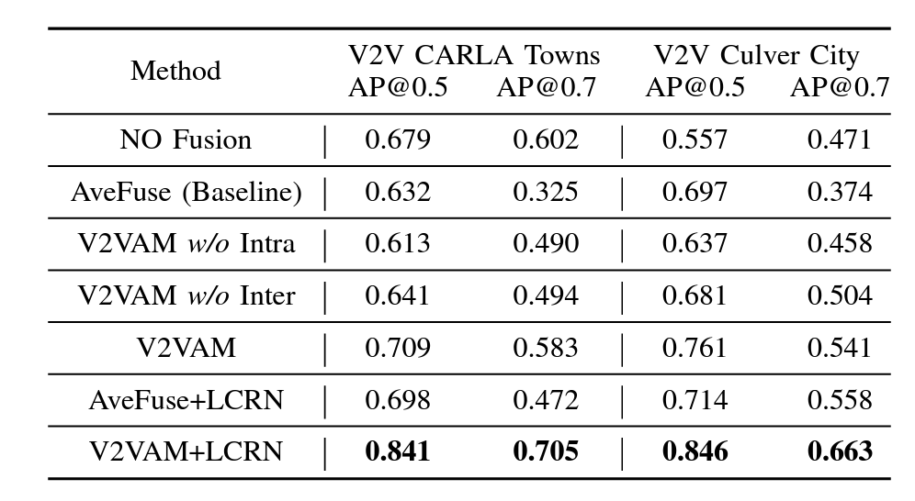
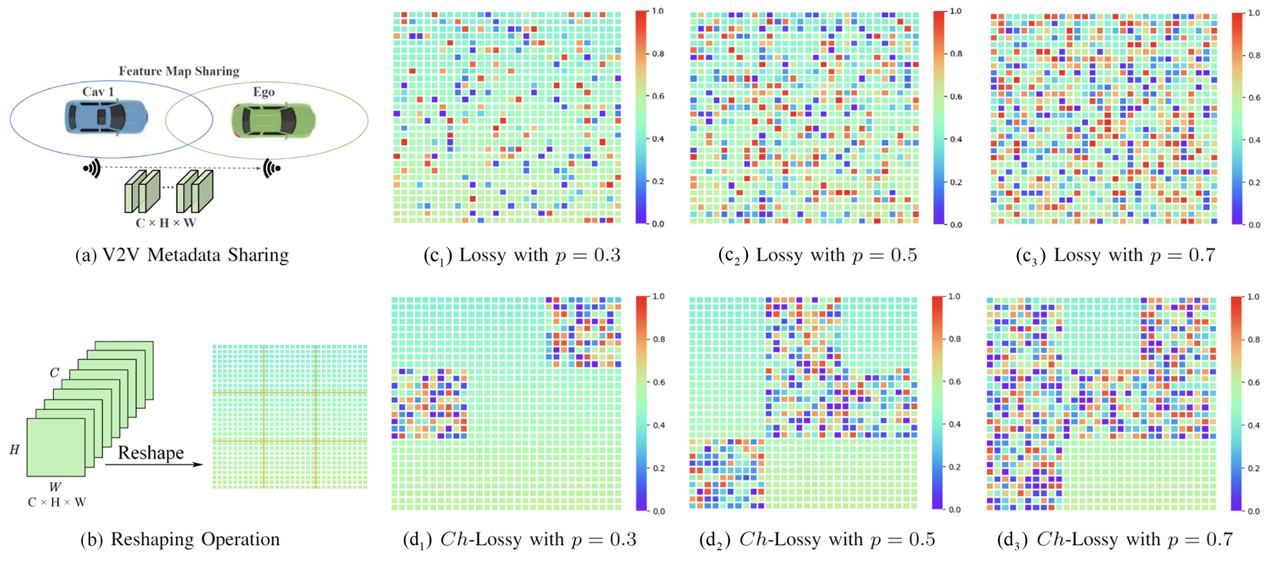
SWIFT: Effective Spectrum Utilization for Coexisting
Active, Semi-passive, and Passive IoT Systems
Ting Zhu, Department of CSE, The Ohio State University
Zicheng Chi, EECS Department, Cleveland State University
NSF Grant: CNS-2305246
NSF Grant: CNS-2127881
Motivation
Background
A rapidly increasing number of IoT devices (25 billion by 2030)
Cost- and labor-intensive IoT maintenance (change/charge battery)
Maintenance-free IoT?
Backscatter Communication (ultra-low power wireless communication)
Battery-free
Harvesting from the environment (Achieving maintenance-free)
Problems?
Low spectrum efficiency
Spotty coverage
Insufficient energy harvesting
Tx
Rx
Backscatter Device
Frequency Agnostic Backscatter System
Proposed System
A backscatter system that can operate across different protocols and frequency bands. This backscatter system can better utilize the spectrum from different frequency bands and seamlessly coexists with existing active senders and passive receivers.
Multi-band Backscatter Tag Hardware
Cross-Layer Design
Coexistence in Heterogeneous Networks
Current Outcome
Sample Level Backscatter
Intermittent ISM Band Signal (e.g., WiFi)
Continuous Wideband LTE Signal
Prototype
Backscattering Throughput in a day (WiFi)
Backscattering Throughput in a day (LTE)
Results
Our system provides a much higher granularity modulation ability than existing systems.
With a similar level of thought, our system can achieve orders of magnitude lower BER.
With a similar level of BER, our system can achieve up to 10 Mbps throughput.
Comparison with State-of-the-art
Existing ISM band backscatter systems (e.g., WiFi, LoRa) suffer intermittent traffic and unreliability
LTE bands provide consistent excitation signals
However, LTE backscatter has unique challenges such as synchronization, long symbol duration, etc.
Results
Across three evaluated scenarios (home, shopping mall, and street), LTE backscatter throughput was much more stable while the WiFi backscatter throughput fluctuated throughout the day. On average, LTE backscatter thought is two orders of magnitude higher.
Learning for Vehicle-to-Vehicle Cooperative Perception under Lossy Communication. IEEE Transactions on Intelligent Vehicles, 2023
our approach to effectively mitigate the negative impact of LC and enhance the interaction between the ego vehicle and other vehicles.
1. [MILCOM'22] Wei Wang, Zicheng Chi, Xin Liu, Ananth Vishnu Bhaskar, Ankit Baingane, Ryan Jahnige, Qingquan Zhang, and Ting Zhu. A Secured Protocol for IoT Devices in Tactical Networks.
2. [ToN'23] Wei Wang, Xin Liu, Yao Yao, Zicheng Chi, Stuart Ray, Ting Zhu, and Yanchao Zhang. Simultaneous Data Dissemination Among WiFi and ZigBee Devices
3. [T-IV’23] Jinlong Li, Runsheng Xu, Xinyu Liu, Jin Ma, Zicheng Chi, Jiaqi Ma, and Hongkai Yu. Learning for Vehicle-to-Vehicle Cooperative Perception Under Lossy Communication
4. [ToN'23] Xin Liu, Zicheng Chi, Wei Wang, Yao Yao, Pei Hao, and Ting Zhu. High-Granularity Modulation for OFDM Backscatter

